Slide 1
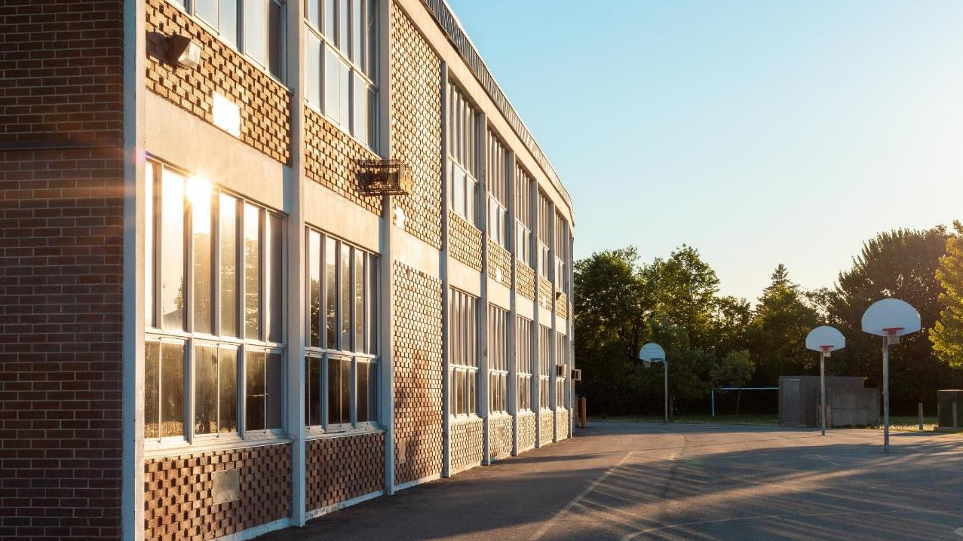

School Safety &
business Continuity

Slide 2

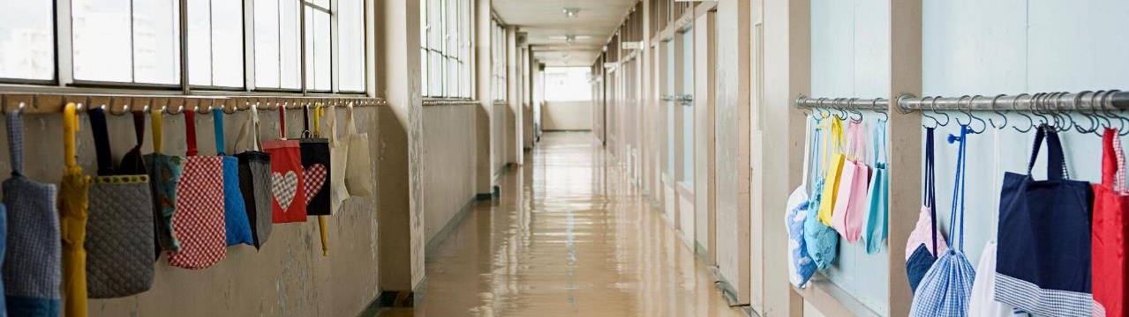
Our mission
Premier Wireless enables innovation, communication, safety, and transformation through technology.
Speaker:
Lea Bogle
Premier Wireless
President & CEO

Slide 3

Planning for the unpredictable
Being prepared for the unexpected
Power Outages
Weather Events
Natural Disasters
School Fights
Medical Emergencies
Active Shooters
Friday Night Football
Other School Events
Prevention
Prepare
Recovery
Response

Slide 4
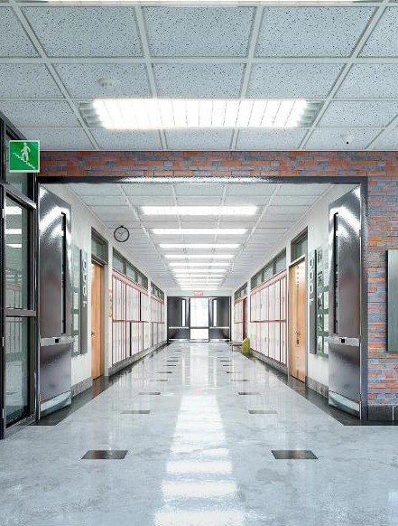
Passpoint coverage challenges
Where are your coverage challenges?
Hallways
Classrooms
Cafeteria
Gyms
Administration offices
Playground
Sporting fields
Parking lots
In Building Wi-Fi
Leverage in-building Wi-Fi for your cell phone to ensure reliable call connectivity
Cellular Coverage enhancements
Distributed Antenna Systems (DAS)

Slide 5

What happens when your network goes down?
Phone systems go down
Background checks can’t be completed
Security systems are compromised
Camera Access is lost
What Other internet-connected devices do you have?
When all else fails… What is Plan B?

Slide 6




SpeedFusion
2
Packets are then decrypted and reassembled into sessions at the remote Peplink device.
MPLS
Fiber
1
Site A
Fiber
2
Fiber
2
Fiber
1
MPLS
Site C
Fiber
2
Fiber
1
3
Transmission and reception are done at the speed of all the WAN links combined. Minus the overhead for VPN.
1
Sessions are encrypted and broken into packets. The packets are then sent across all available WAN connections.
Site B
MPLS

Slide 7

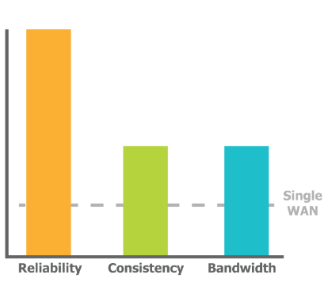
Hot failover: SpeedFusion
WAN 1
WAN 2
Enables you to change connections while keeping your session intact.
Useful for deployments where you need
reliability while keeping costs down.

Slide 8
Peplink’s SD-WAN: SpeedFusion
CORE Technologies
BB
Bandwidth Bonding
Combine the speed and bandwidth of multiple WAN connections.
WAN Smoothing
Use multiple WAN connections to create a single, jitter-free data stream.
WS
HF
Hot Failover
Switch from one WAN connection to another while keeping your sessions intact.
PepVPN
Offers the benefits of IPsec, plus a variety of performance and reliability features.
PV

Slide 9
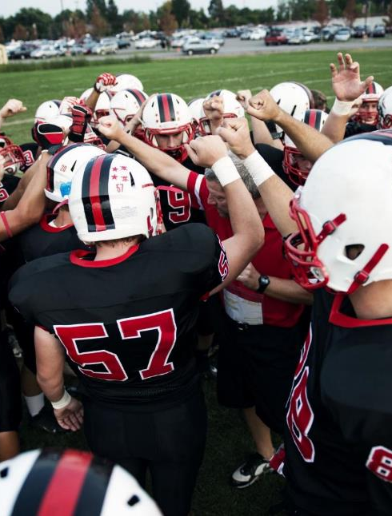
Where do you lack internet Access?
Fixed wireless access (FWA)
AG Barns
Bus Barnes
Maintenance Shops
Football, Baseball, or Soccer Fields
Parking Lots
Digital Signage
Communication and continuity, at all times, everywhere!

Slide 10
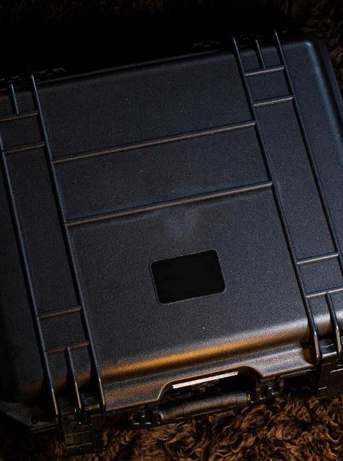
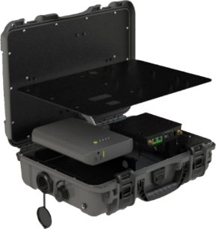
Portable Cellular Wi-Fi Network
Premier’s 5g mobile network-in-a-box
Emergency Response
Business Continuity
Field Trips
Portable Command Center
50-150 (or more) Endpoints
Communication Continuity
IP68 Rated for Water & Dust

Slide 11





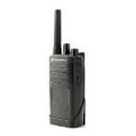
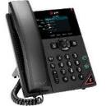

Voice & Data Communication
Desk Phones – Smart Phones – Basic Phones & Radios
UCaaS
Desk Phones & Cell Phones
Laptops & Tablets
Right Devices For The Right Person
District Administrators
School Resource Officers
Principals/Assistant Principals
School Nurse & Counselors
Teachers
Facilities - Technology – Warehouse
Food & Nutrition – Landscaping
Transportation
We can help you create a truly Unified Communication Plan!

Slide 12
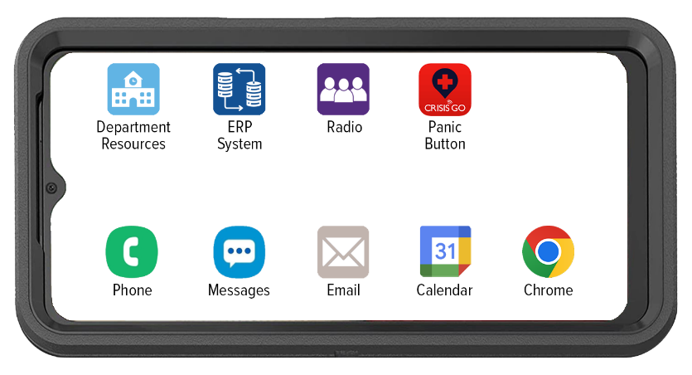
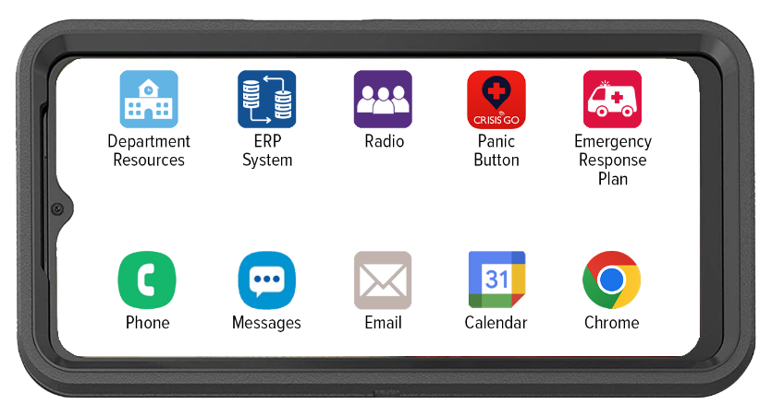
Premier WIRELeSS’ CPR³ Solution for Administration & Staff
Connecting People To Resources

Slide 13

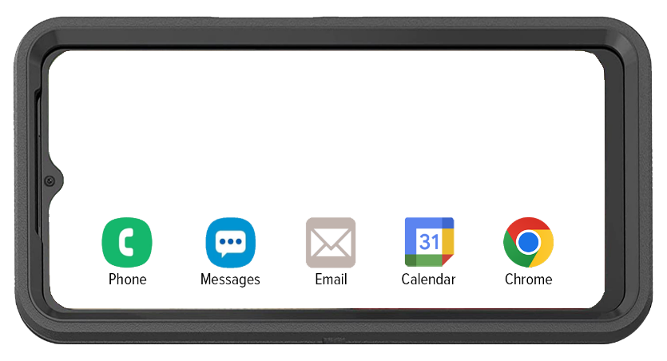
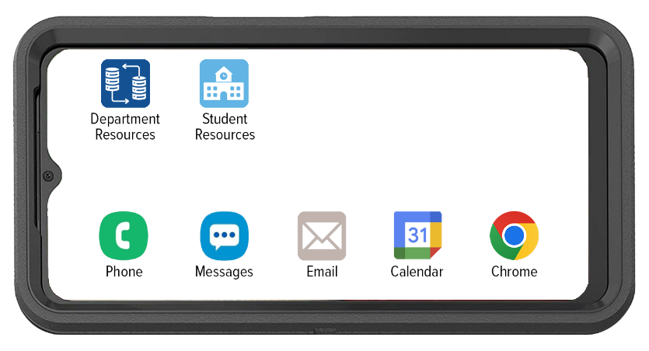

Premier WIRELeSS’ CPR³ Solution for Administration & Staff
Connecting People To Resources
Department Resources
Facilities
Landscaping
Food & Nutrition
Technology
Work Orders

Slide 14
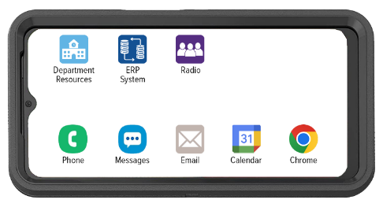




Cellular Based 2-Way Radio
Easily communicate with other cellular-based 2-way radio users without the need for 2 devices
Provides location sharing and tracking capabilities for precise coordination
Interoperability provides the ability to communicate with other Land Mobile Radio (LMR) devices
Allows supervisors to centrally manage contacts, Talk groups, and settings with the Corporate Administration Tool (CAT)

Slide 15
Purpose Driven & Poised for emergency response

Slide 16
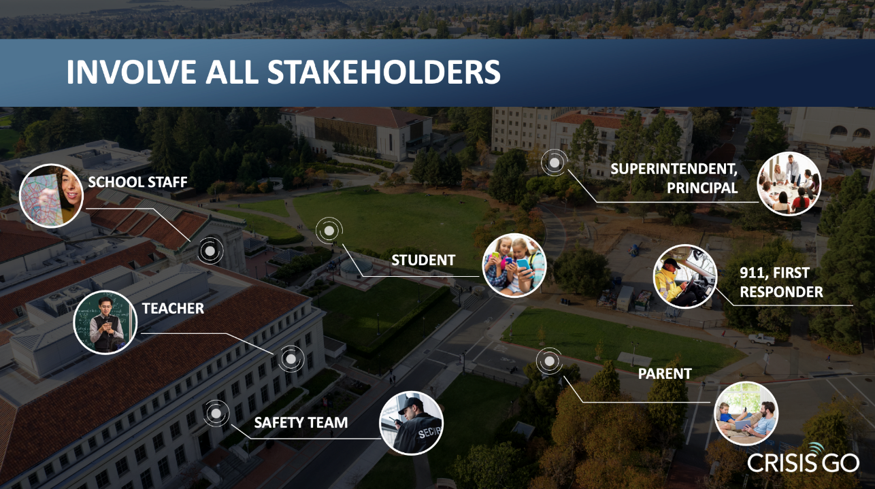

Slide 17
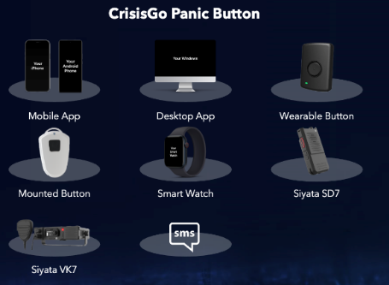


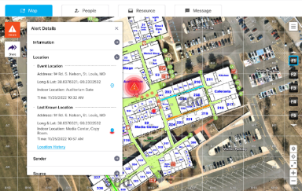
CrisiSGo: Prepare
DIGITIZE YOUR EMERGENCY RESPONSE PLANS
ROLE-BASED INCIDENT MANAGEMENT
INTEGRATE YOUR FACILITY MAPS FOR INDOOR LOCATION TRACKING

Slide 18

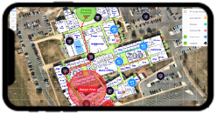
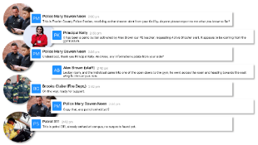
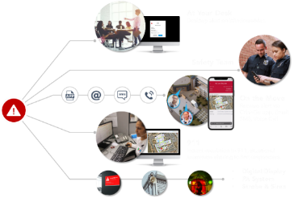



CrisisGo: response
AWARENESS
MASS NOTIFICATION
SYSTEM
PARENTS
GUARDIANS
COMMUNITY
CRISISGO ACTIVATION
RECOVERY
COORDINATION
TEACHERS
STAFF
POLICE
FIRE
ISD ADMINS
INCIDENT RESOLUTION
INCIDENT RESPONSE
SYSTEM

Slide 19
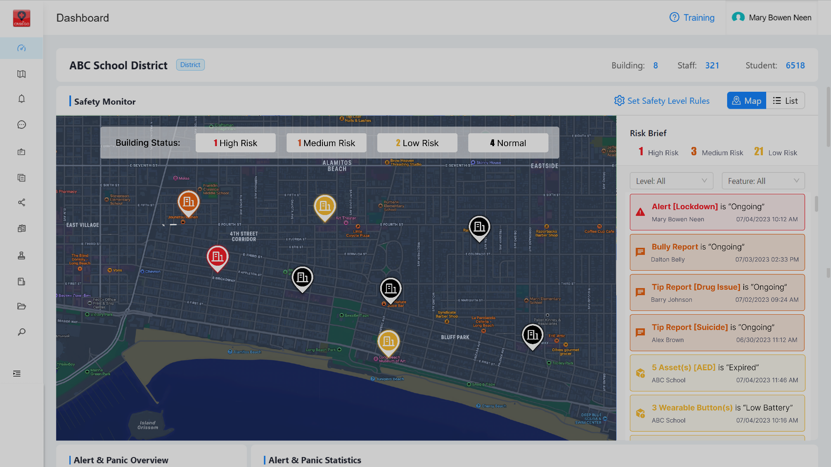
System-of-system approach
A complete oversight of every facility

Slide 20
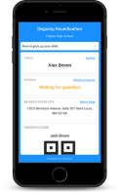
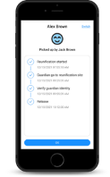
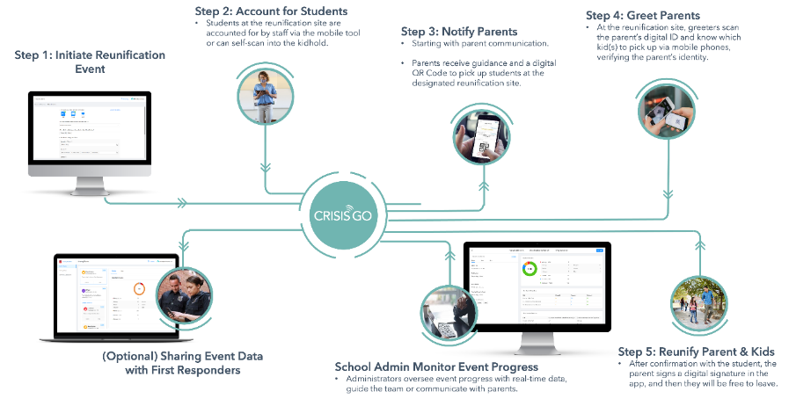
CrisisGo: recovery

Slide 21

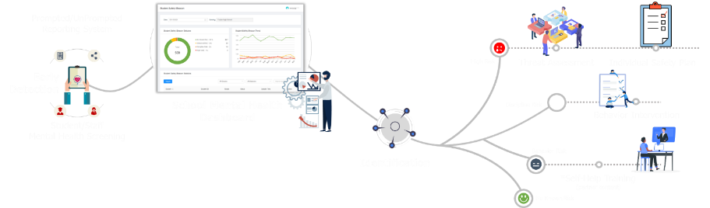
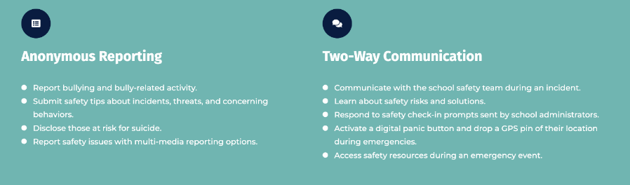
CrisisGo: prevention

Slide 22
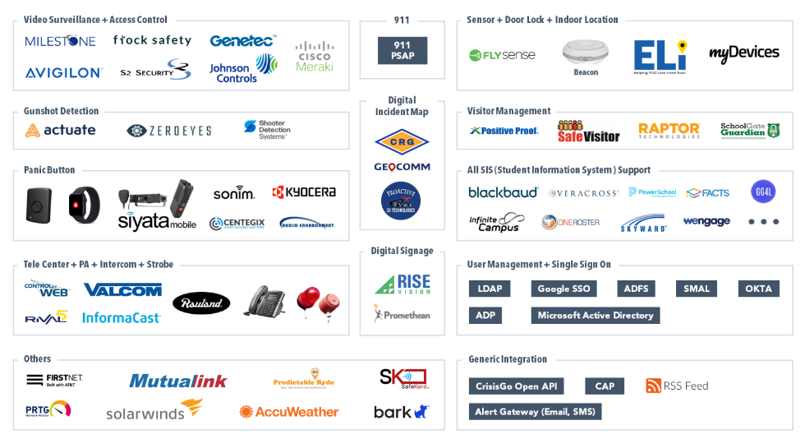
CrisisGo: Partners

Slide 23
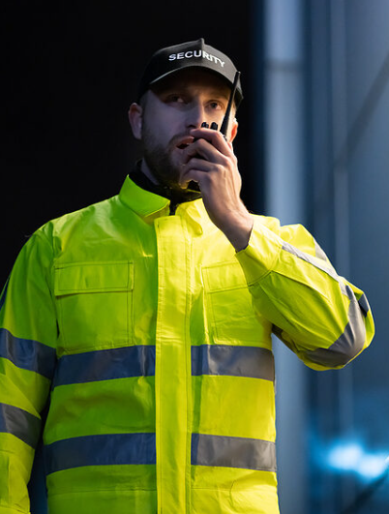
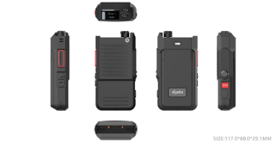
Cellular-based radios & ptt devices
Purpose-driven, rugged devices
One-to-One
One-to-Many
Group Talk
Broadcast
SOS Button
Perfect for:
Front Desk
Custodial Staff
Transportation
Landscaping

Slide 24
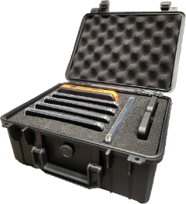
Always ready to go
Increase your response capabilities with a go-kit
Pre-loaded and pre-programmed with your choice of devices. Choice of…
Smart Devices
Hotspots
Tablets
Radios
Perfect for…
Providing adding people to the response team
Substitute Teachers
Friday Night Football & other events

Slide 25


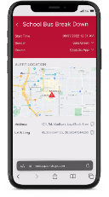
ConnectEd bus: Communication
Cellular Based 2-Way Radio
One-to-One Communication
One to a Subgroup
One to All
Perfect for after-hour Transportation Director and Administrator Communication with trip buses.

Slide 26

ConnectED Bus: BUS WI-FI
Wi-fi for educational purposes
E-Rate Eligible
Bus Wi-Fi for Student Learning
CIPA Compliant
Secure Student Sign-on
Wi-fi for school bus safety
Real-time Remote Camera Access
Real-time GPS Location
Reduces Disciplinary Challenges
Up 10% of Data can be paid for by E-Rate

Slide 27

Connected Bus: Crosswalk
School bus safety through Fleet Management
Real-time GPS & Routing Integration
Student Tracking & Parent App
Turn-by-Turn Driving Directions
Pre & Post Trip Inspections Reporting
School Information System Integration
Non-Compliance Alert Notifications

Slide 28

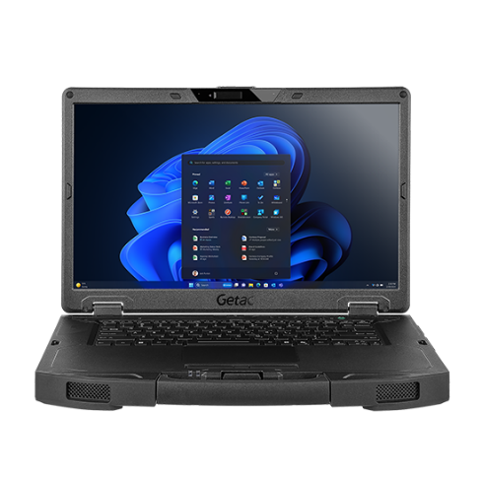

Connected school officers
In-Vehicle Router
MDTs
Laptops/Tablets
Body Worn Camera

Slide 29

We’re here to help.
(281) 667-0404
www.premierwireless.com

